Slide 1


Deliverable 3 Team Progress Report SEXUALLY TRANSMITTED DISEASES INFORMATION APP
Across The Board Champion
Xueting Chen(Presenter), Yoshihisa Miyamoto, Changrui Zhang, Anil Gadgotra, Divya Datla, Prashanth Subrahmanyam
CS6440: Introduction to Health Informatics
March10th, 2019
Notes:
Hi, this video is to show the progress of our project

Slide 2
Video Link to Presentation
https://youtu.be/EdiqTuReZBU

Slide 3
Agenda
Present the project progress
Further research and next steps
Gantt Chart update

Slide 4
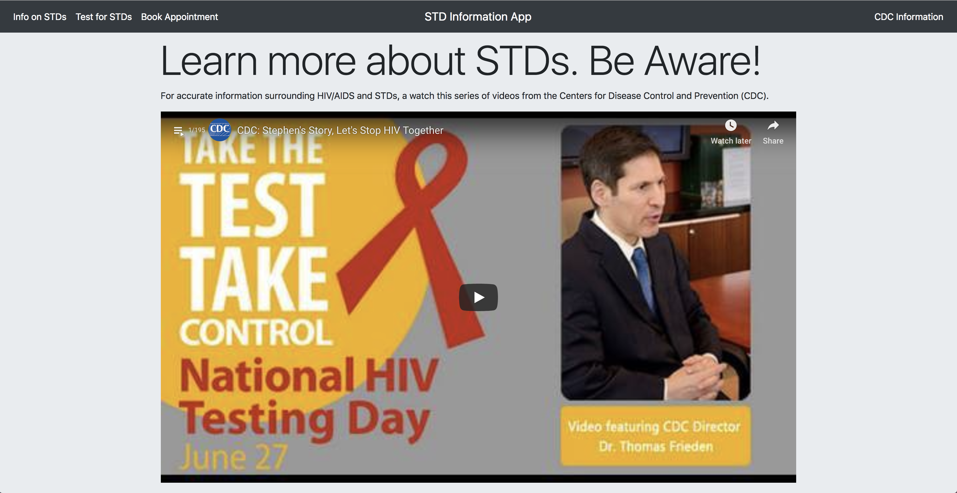
Project progress - Awareness
Notes:
Sexually transmitted diseases (STDs) are among the most common infectious diseases in the United States today. it becomes important to create awareness as well as provide easy availability of resources. When users open our web app, they can watch a list of videos covering STD information and how to prevent the diseases. New videos will be automatically added when the playlist is updated.

Slide 5
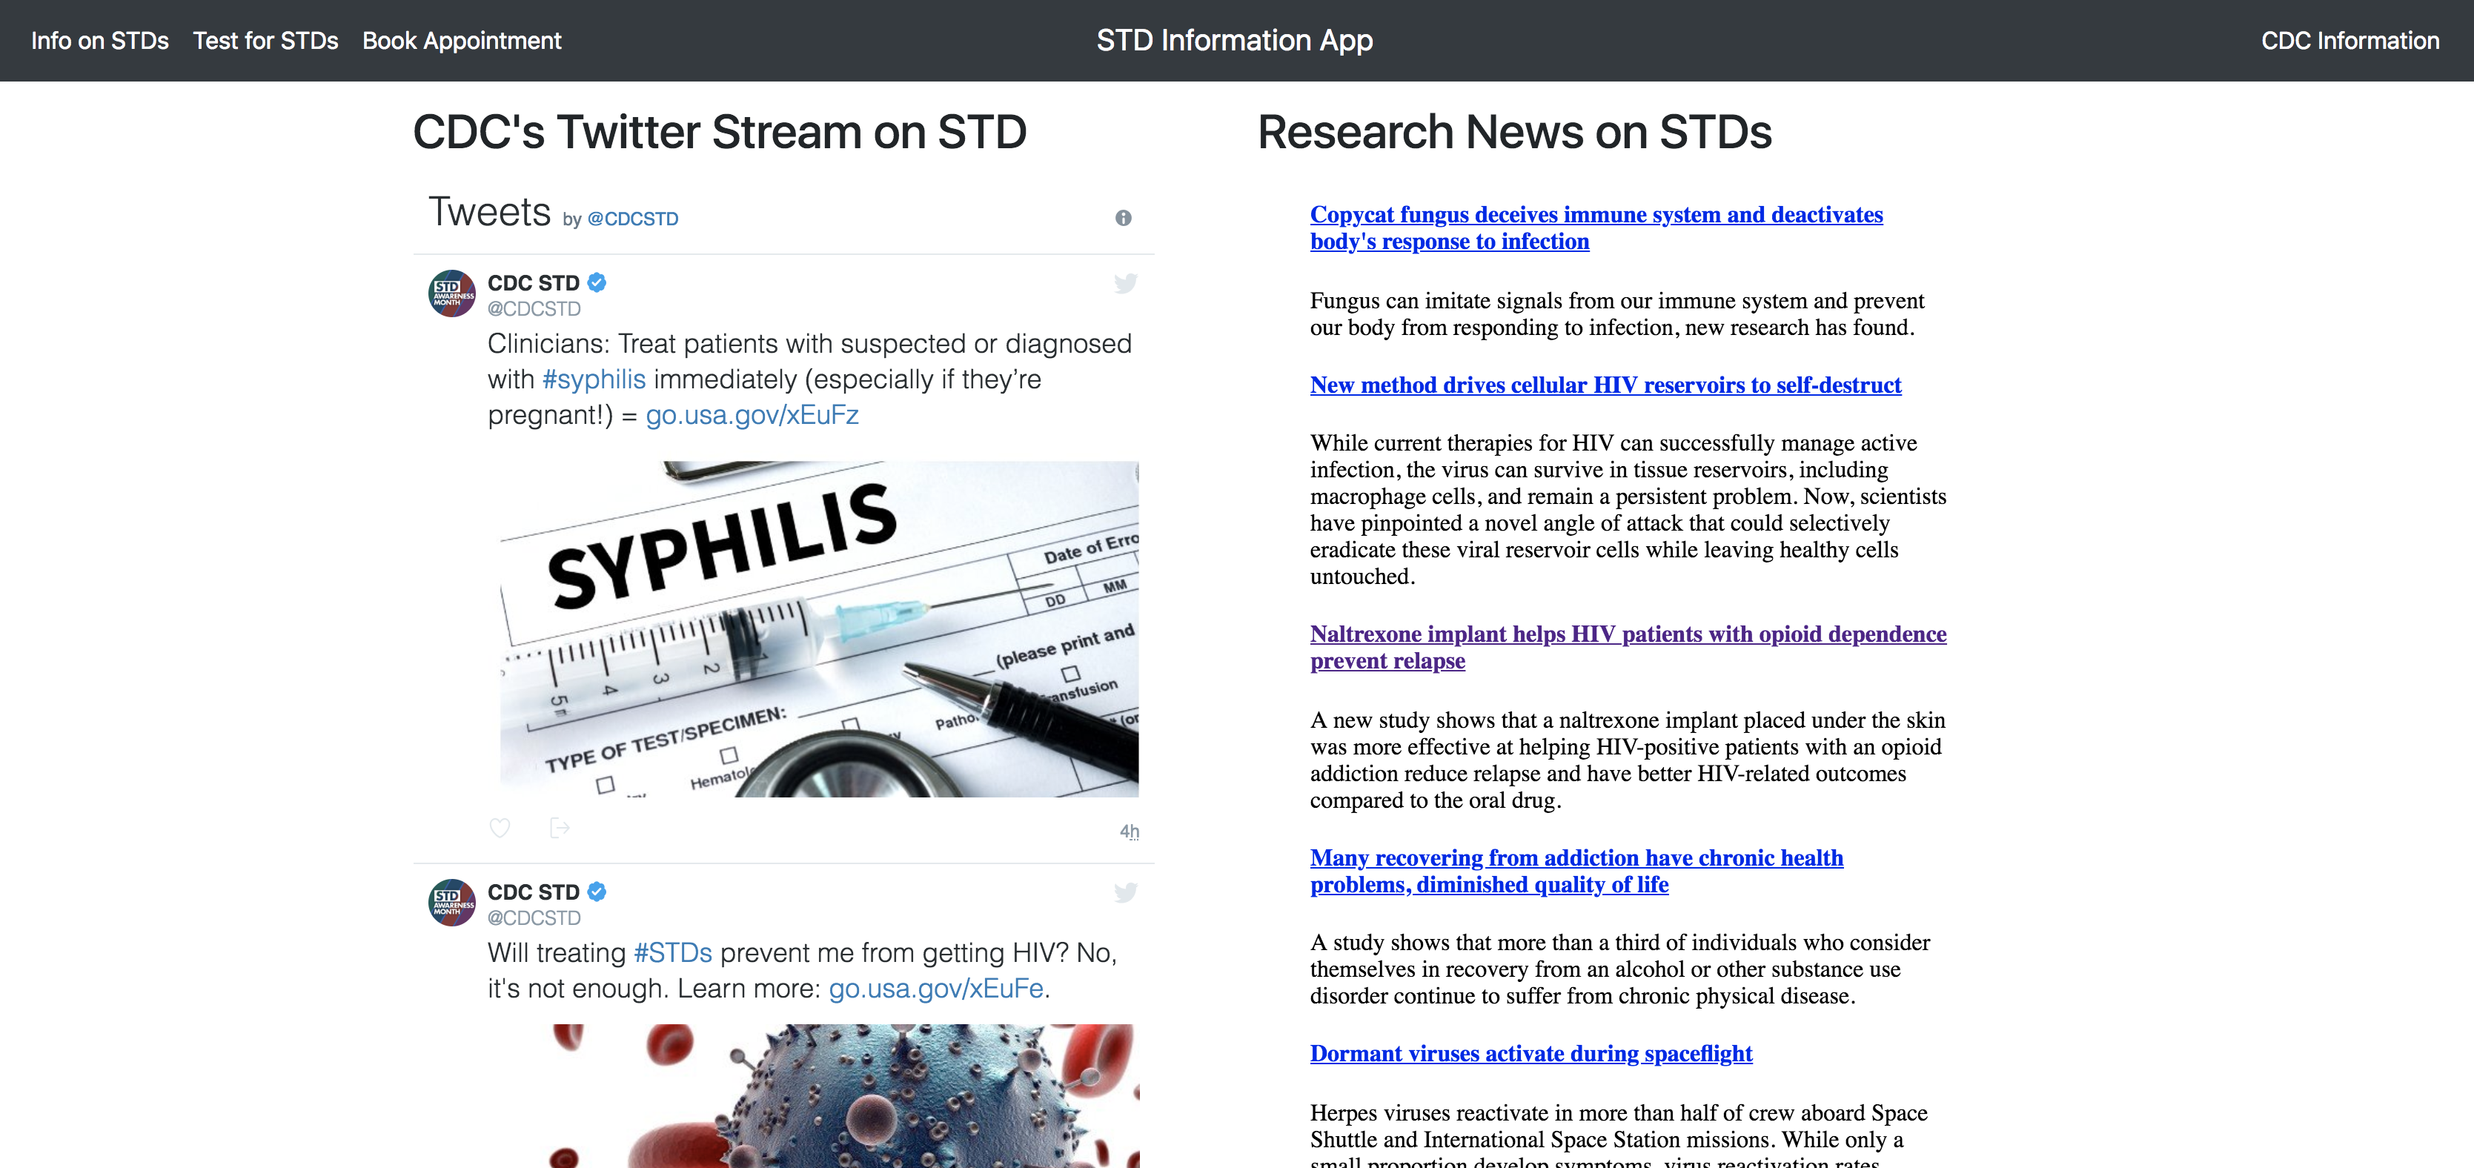
Project progress - Awareness
Notes:
Scrolling down the page, we also ingested CDC’s twitter feed and research news from science daily. Both will be updated automatically.

Slide 6
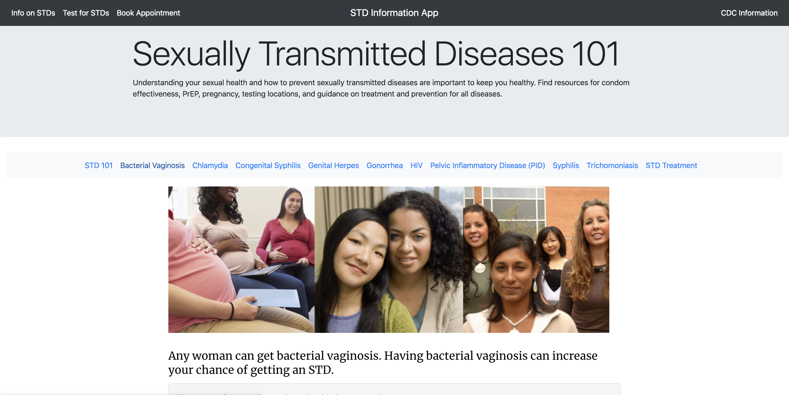
Project progress - Awareness
Notes:
On the top right corner, when users click cdc information, it directs to a page showing all fact information of different STDs and how to prevent them.

Slide 7
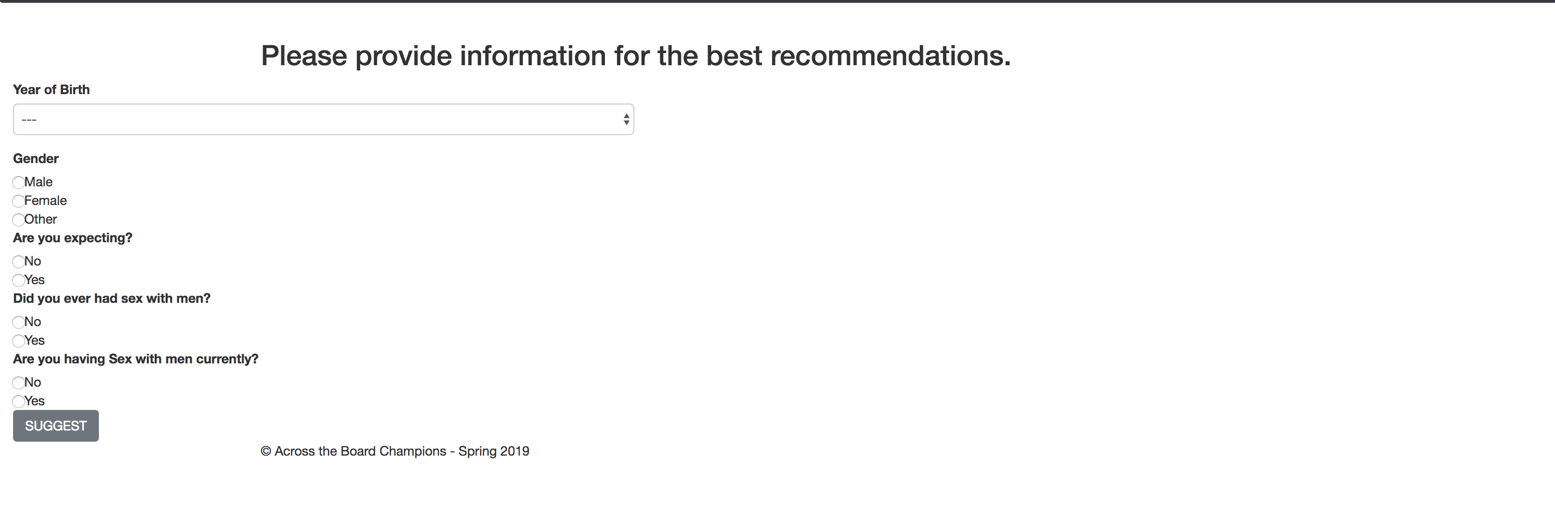
Project progress - Suggestion
Notes:
We also have the ability to recommend STD tests. When users clikc test for STDs, they can answer five questions and click suggest.

Slide 8
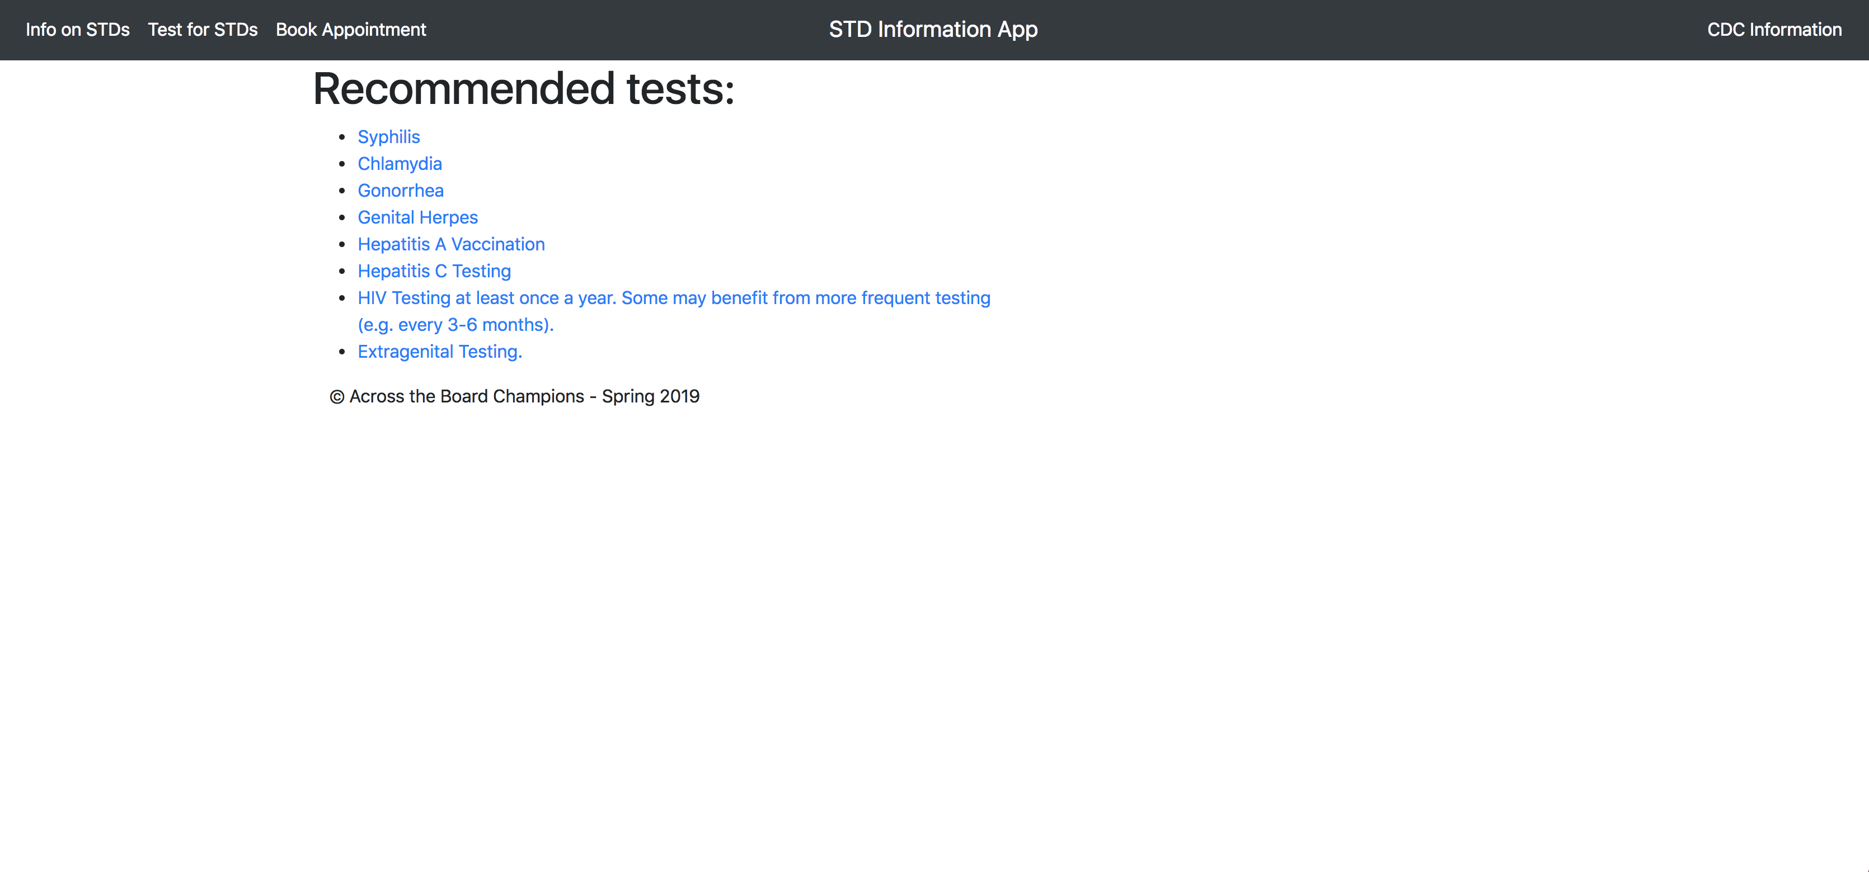
Project progress - Suggestion
Notes:
Our app will return a list of recommended tests based on the answers.

Slide 9
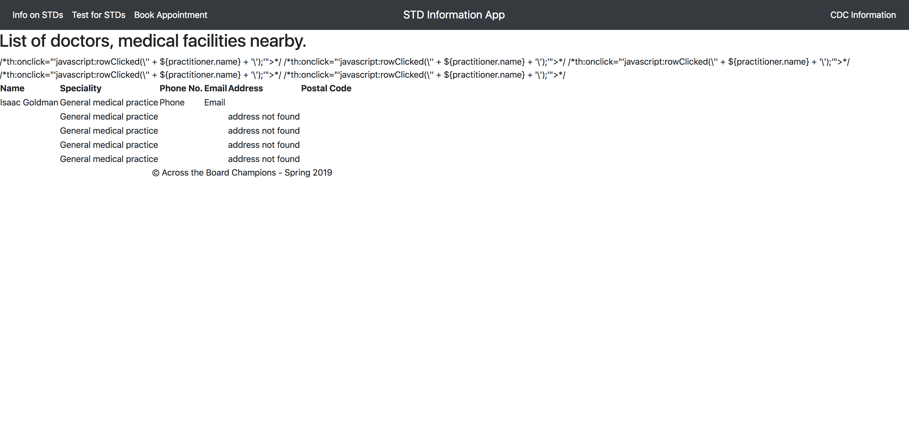
Project progress - Booking
DEMO
Notes:
When users click book appointment, a list of nearby doctors and medical facilities will show up. Users can select the one they want to visit.

Slide 10
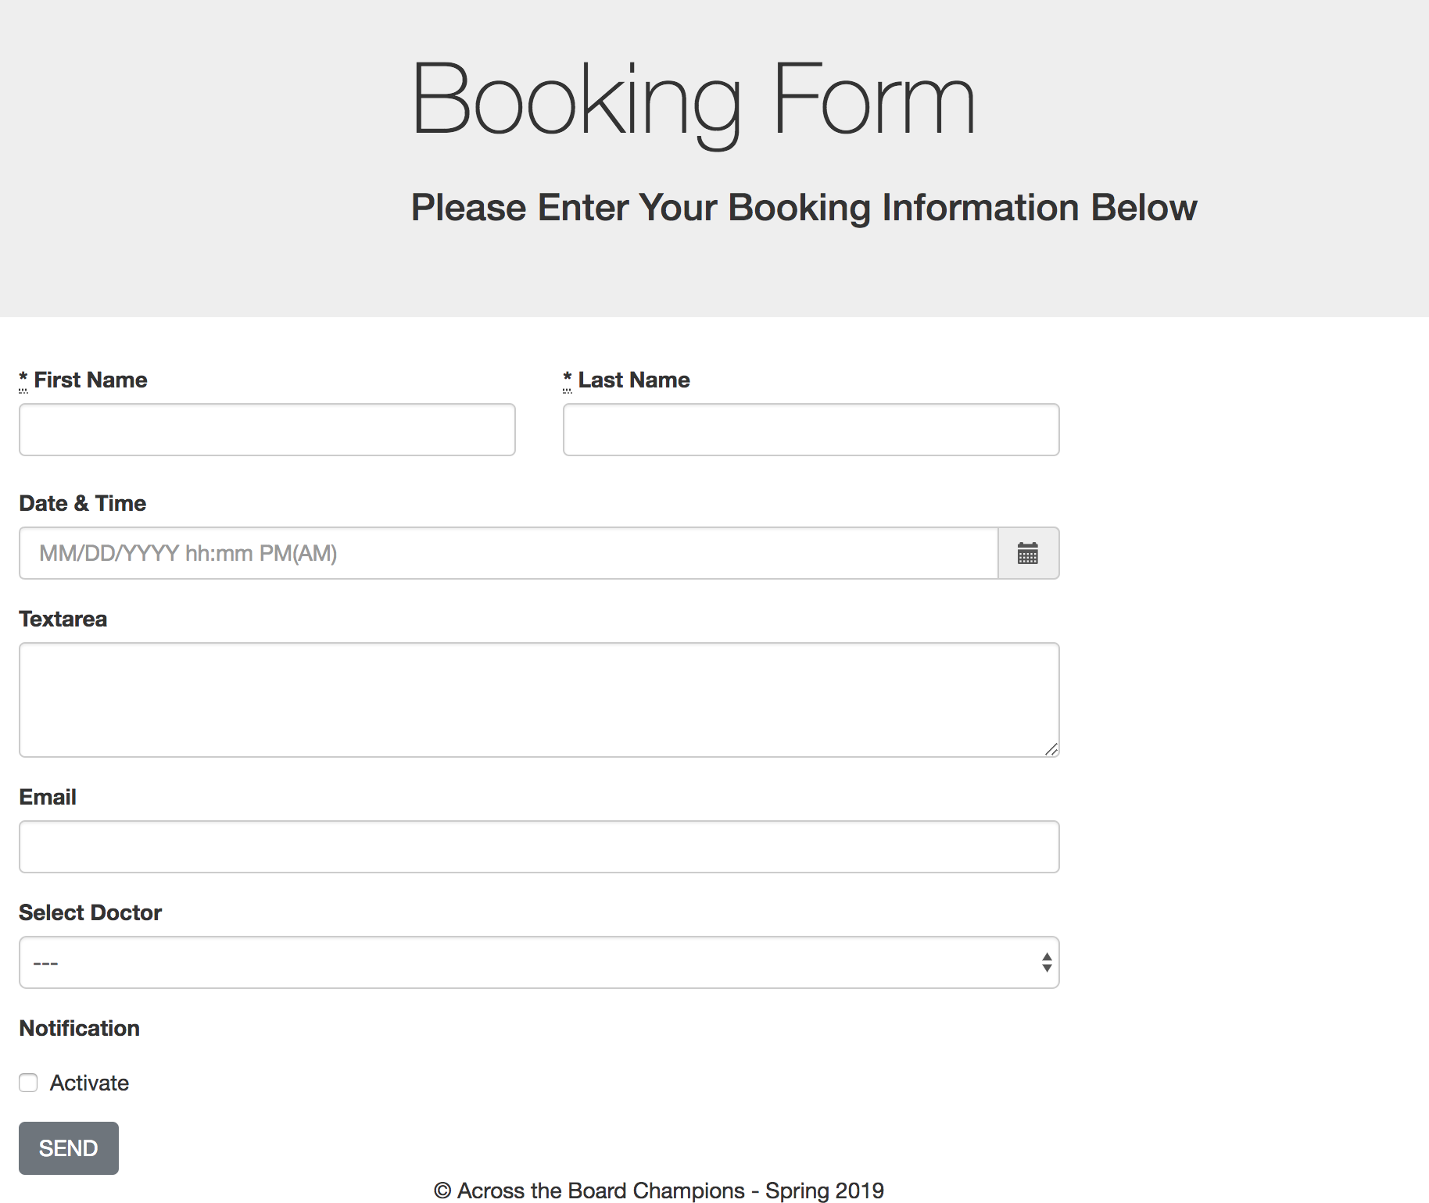
Project progress - Booking
DEMO
Notes:
Then a booking form will pop up, where users can fill their information and desired appointment time. We will provide a template email so that it’s easier for users to send the request.

Slide 11
Further steps
Polish UI
Sign in, Sign up
Information Store
Tailor News

Slide 12
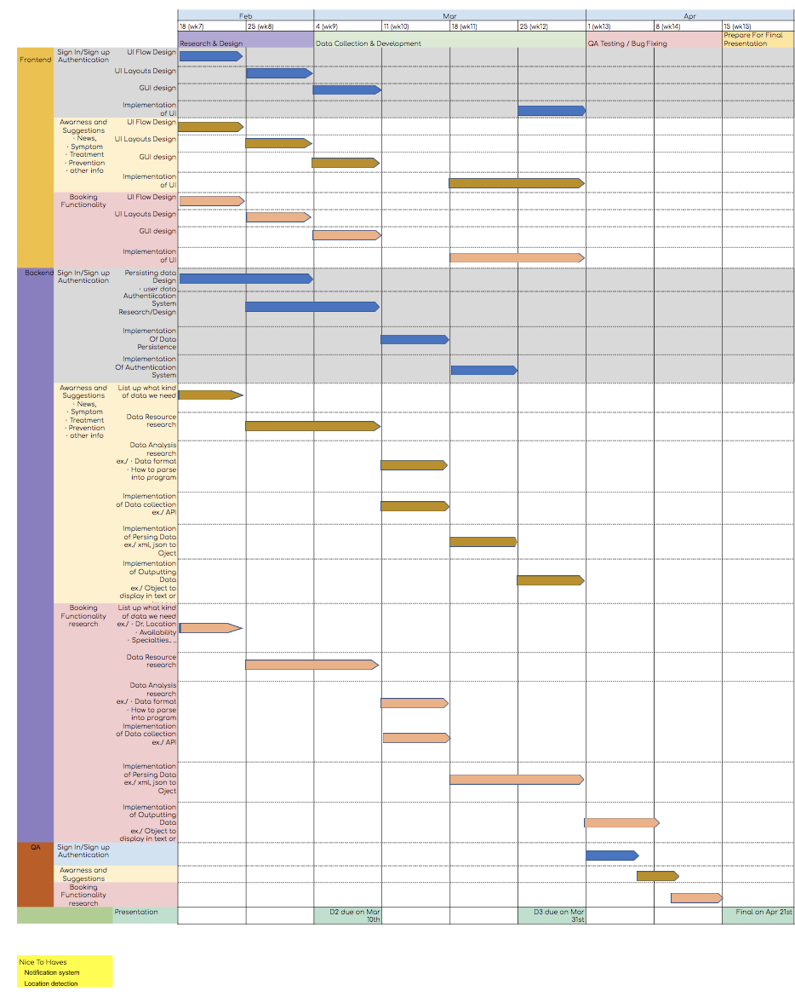
Gantt Chart
Front End
Awareness (Prashanth)
Suggestion (Anil)
Booking (Yoshi)
Back End
Awareness (Divya)
Suggestion (Changrui)
Booking (Yoshi)
Database Design (Anil)
Testing (Xueting)
Notes:
As introduced, we have three main functions: awareness, suggestion and booking.

